Slide 1
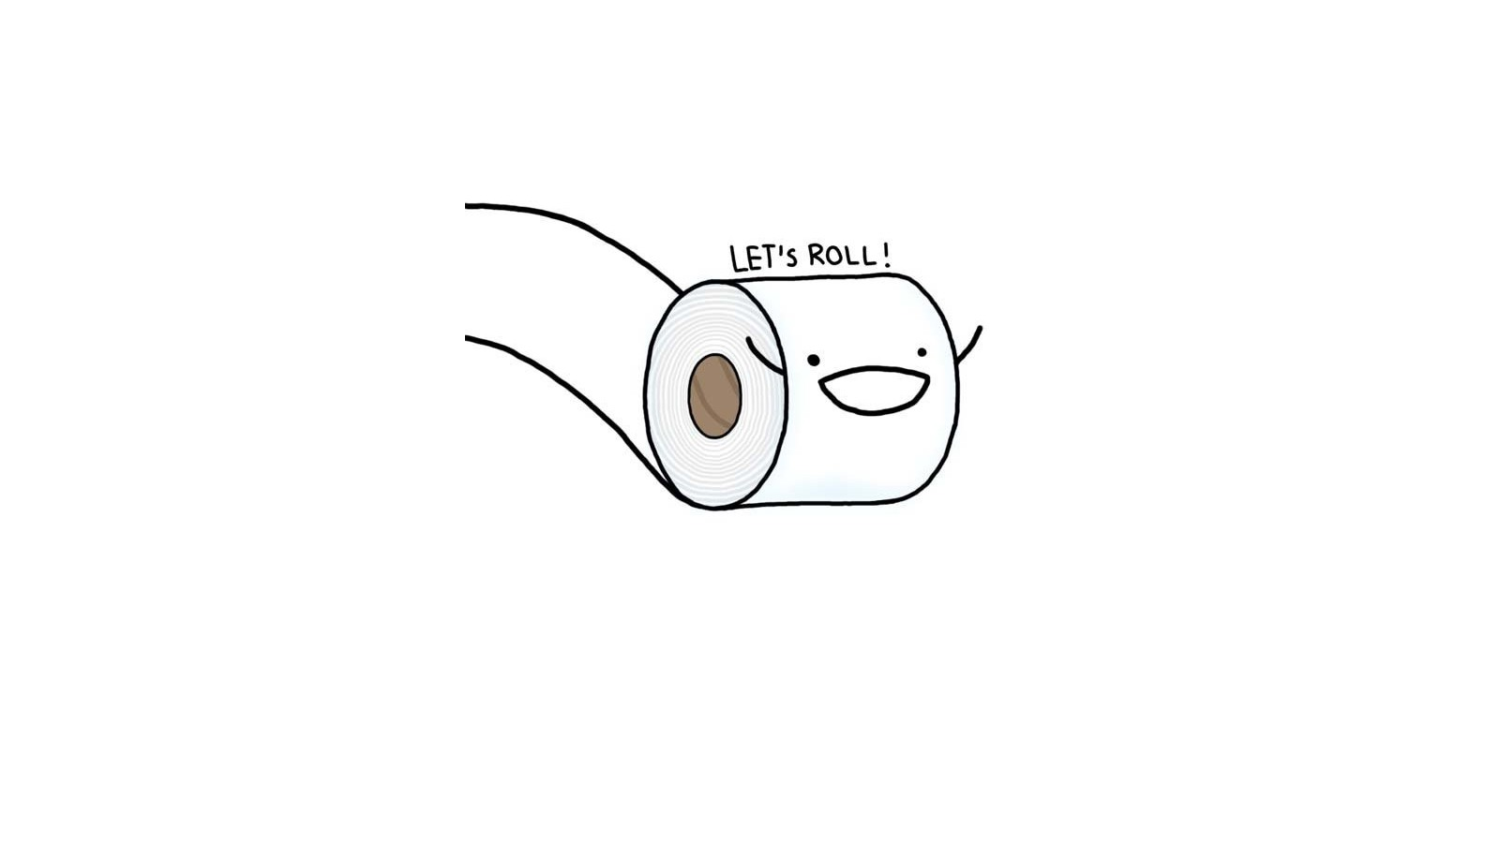
Storyboard for The Last Toilet Paper
Avinash Gupta
G01009180

Slide 2
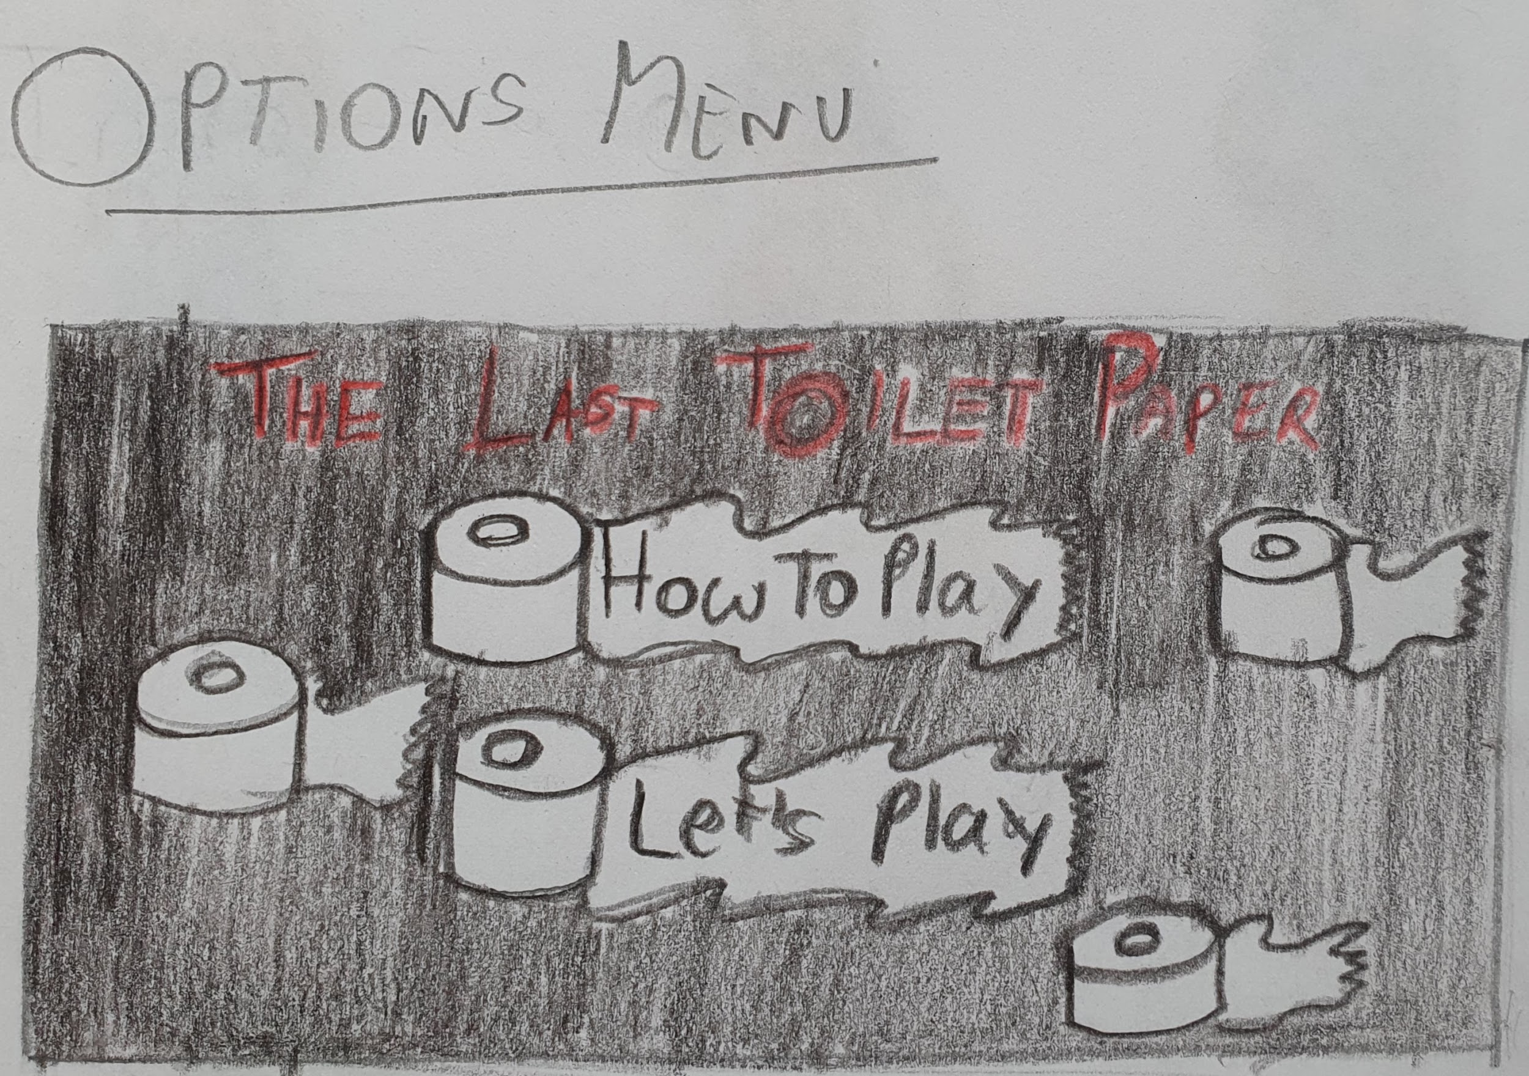
Options Menu

Slide 3
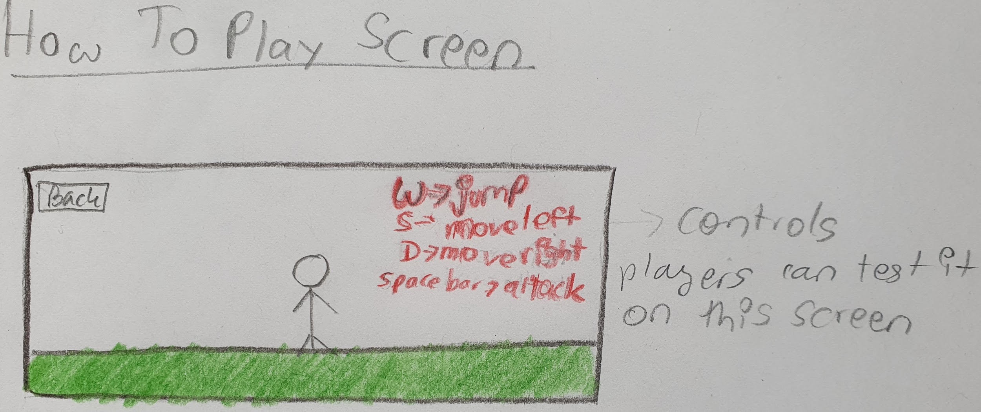
How To Play Screen

Slide 4
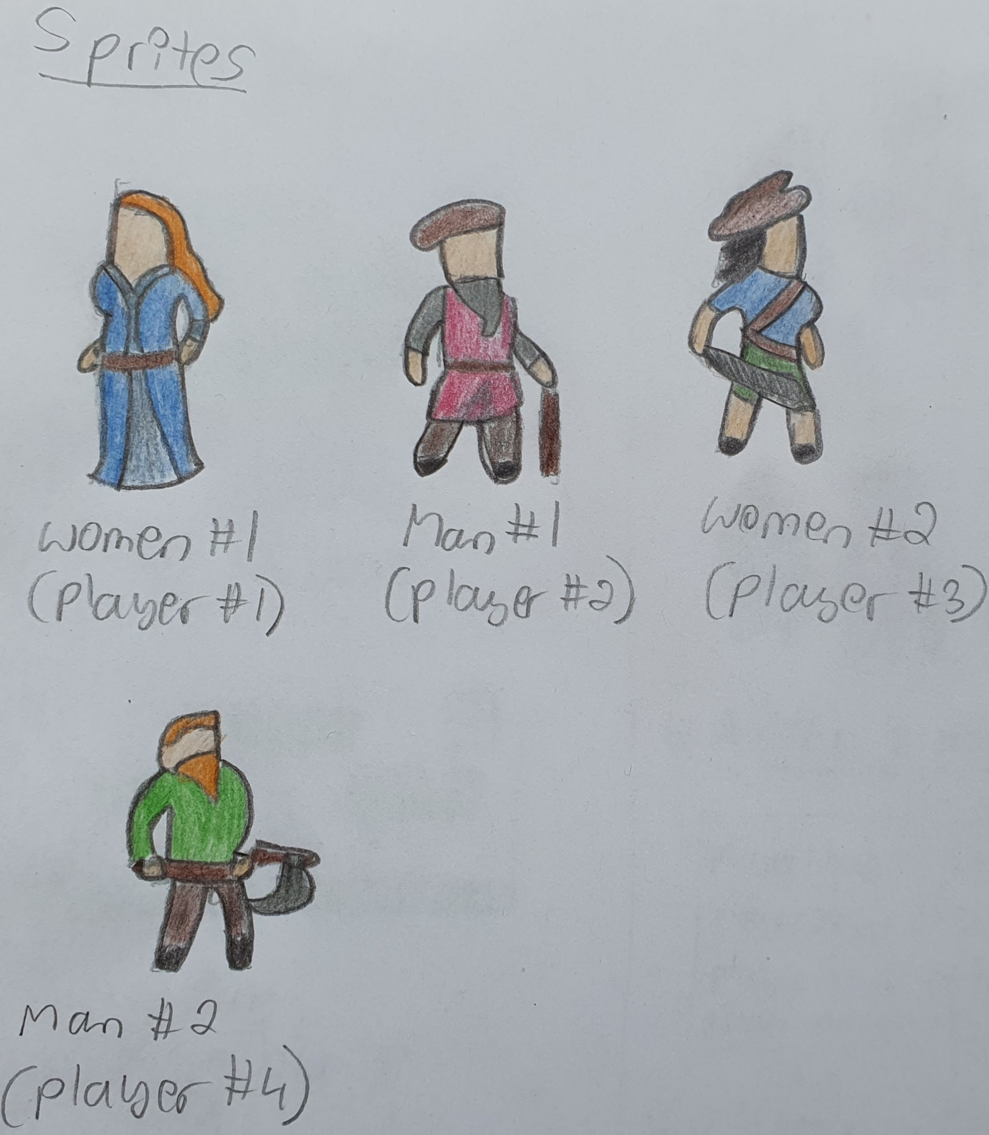
Sprites

Slide 5
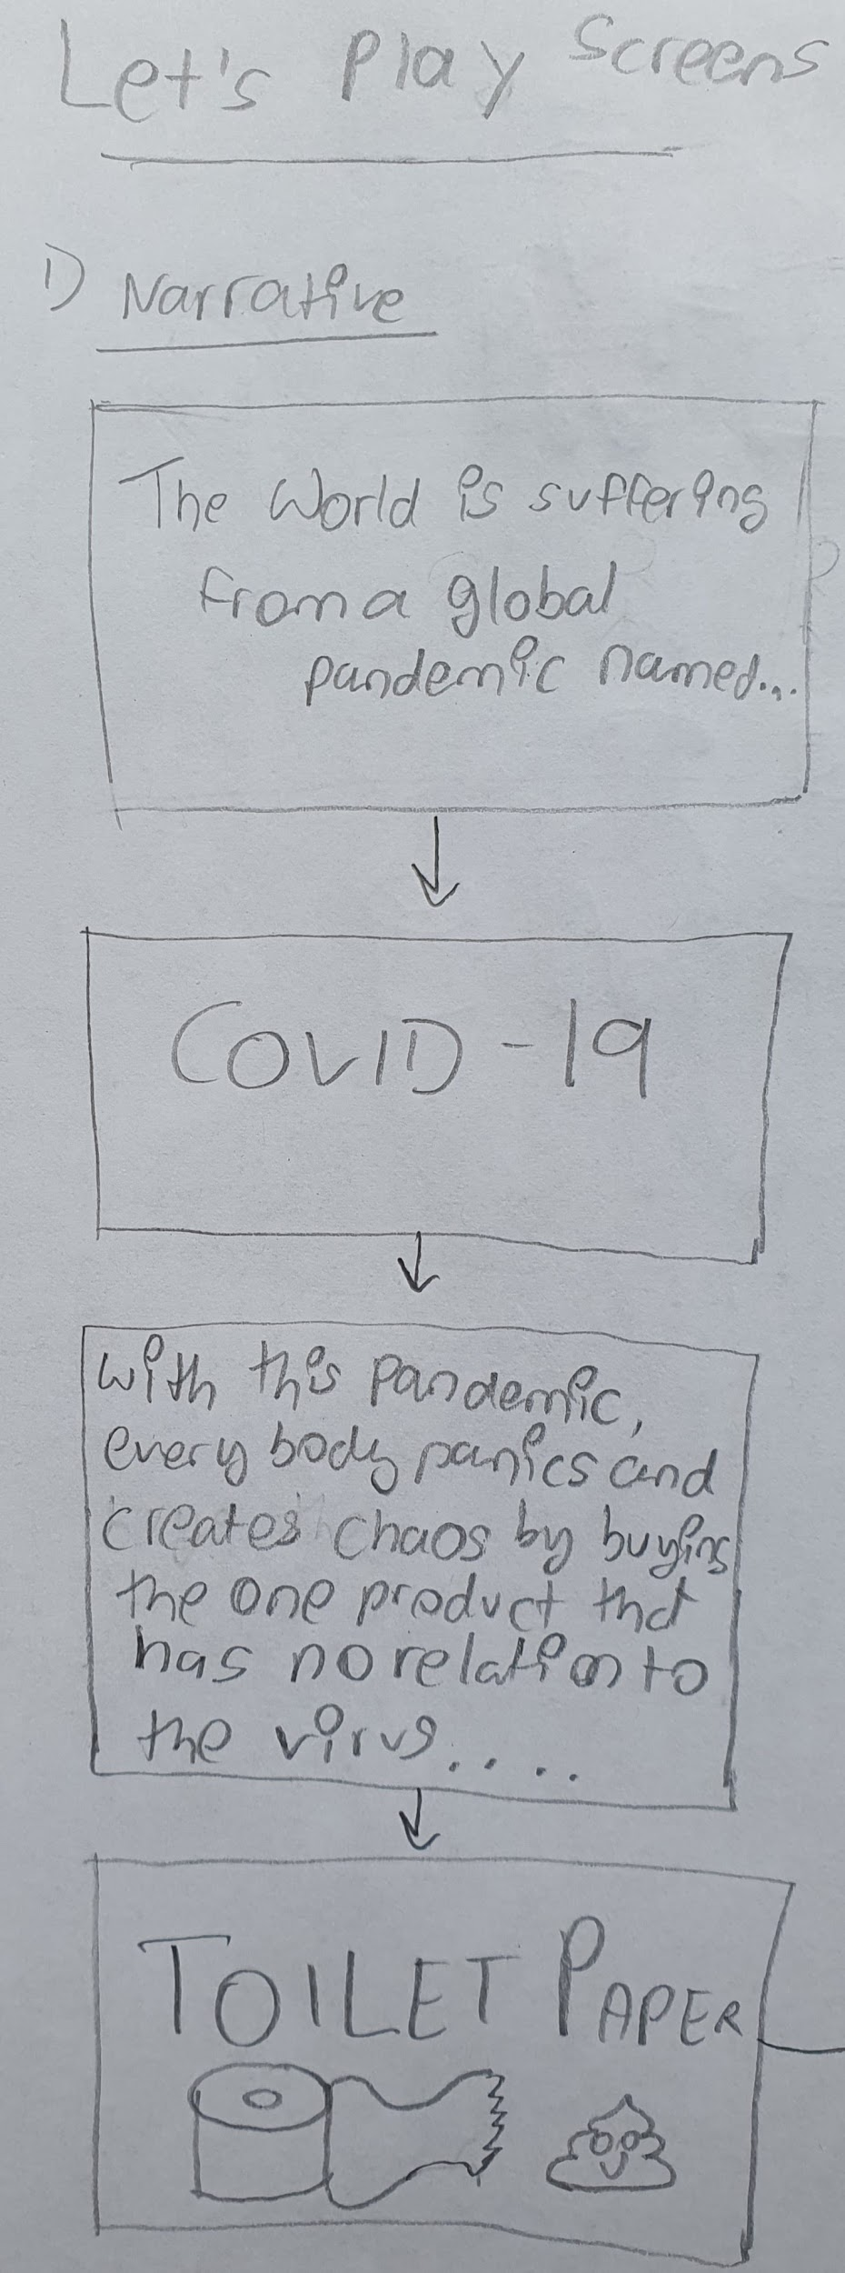
Let’s play scenes

Slide 6
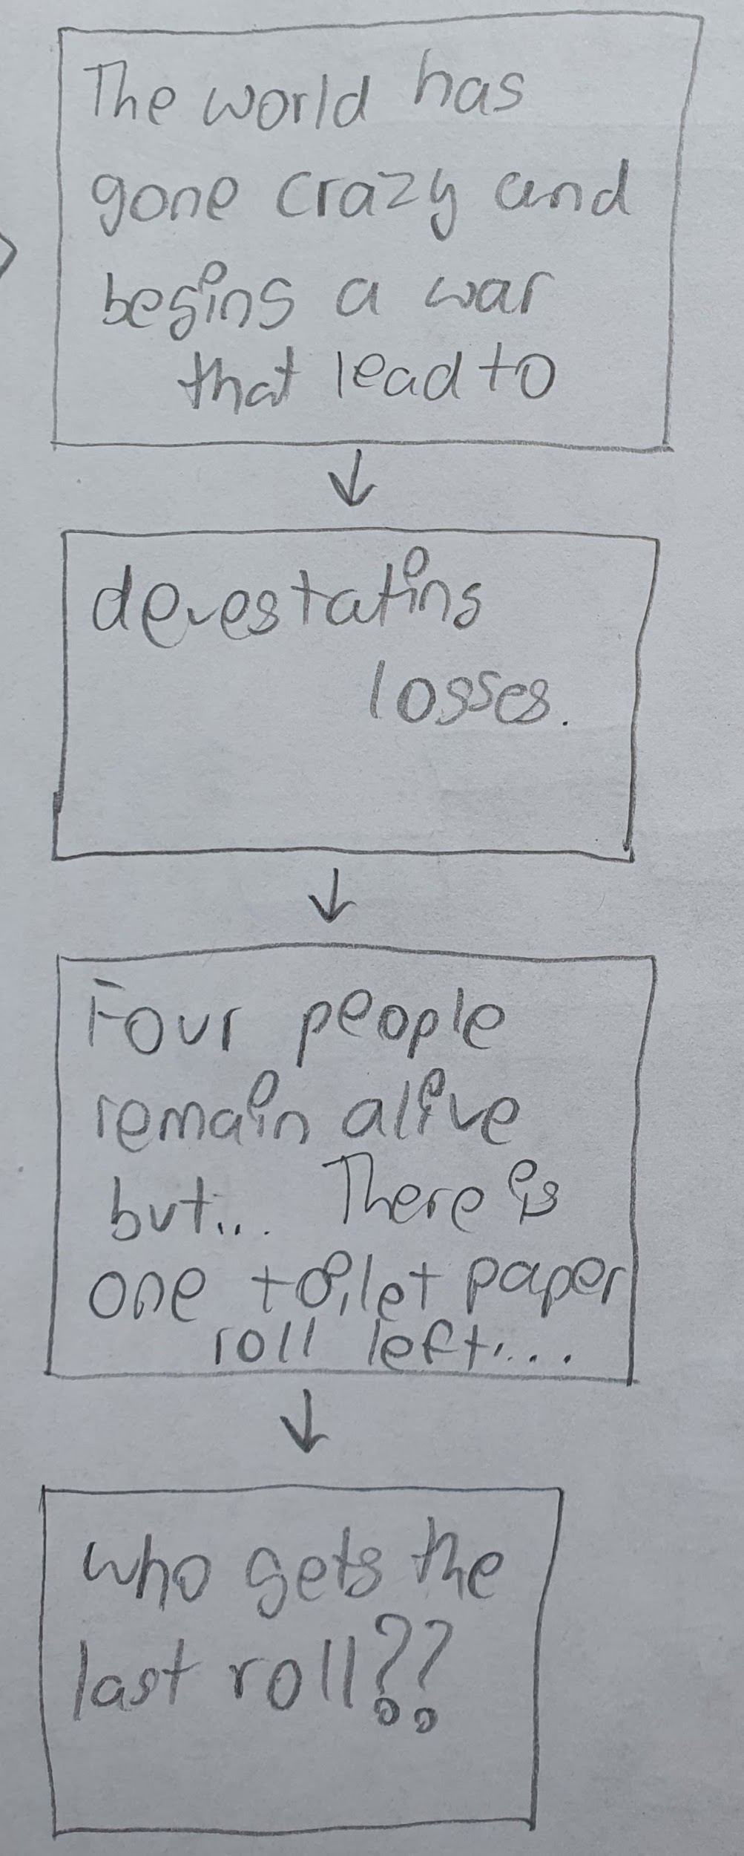
Continuation

Slide 7
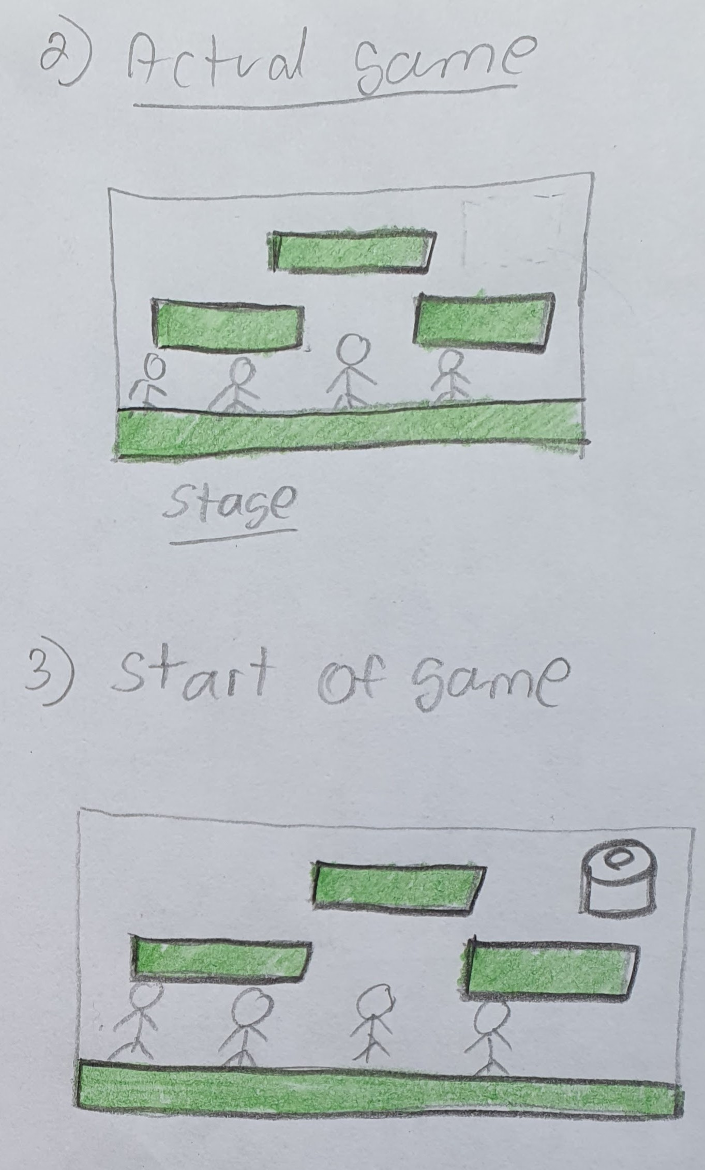
Actual Game

Slide 8
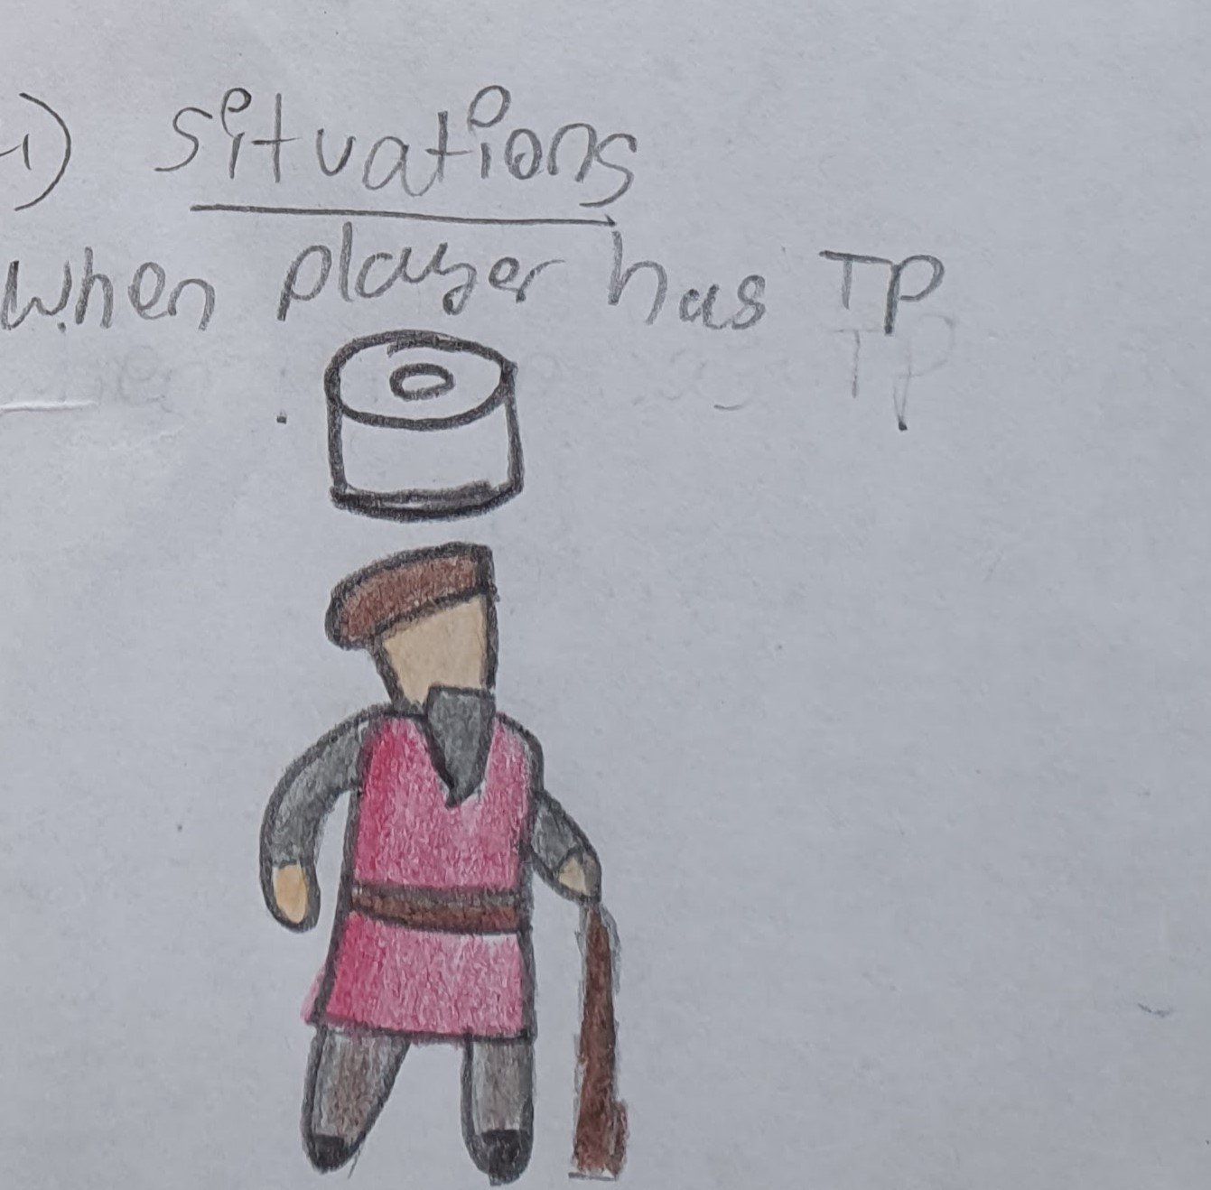
Situations

Slide 9
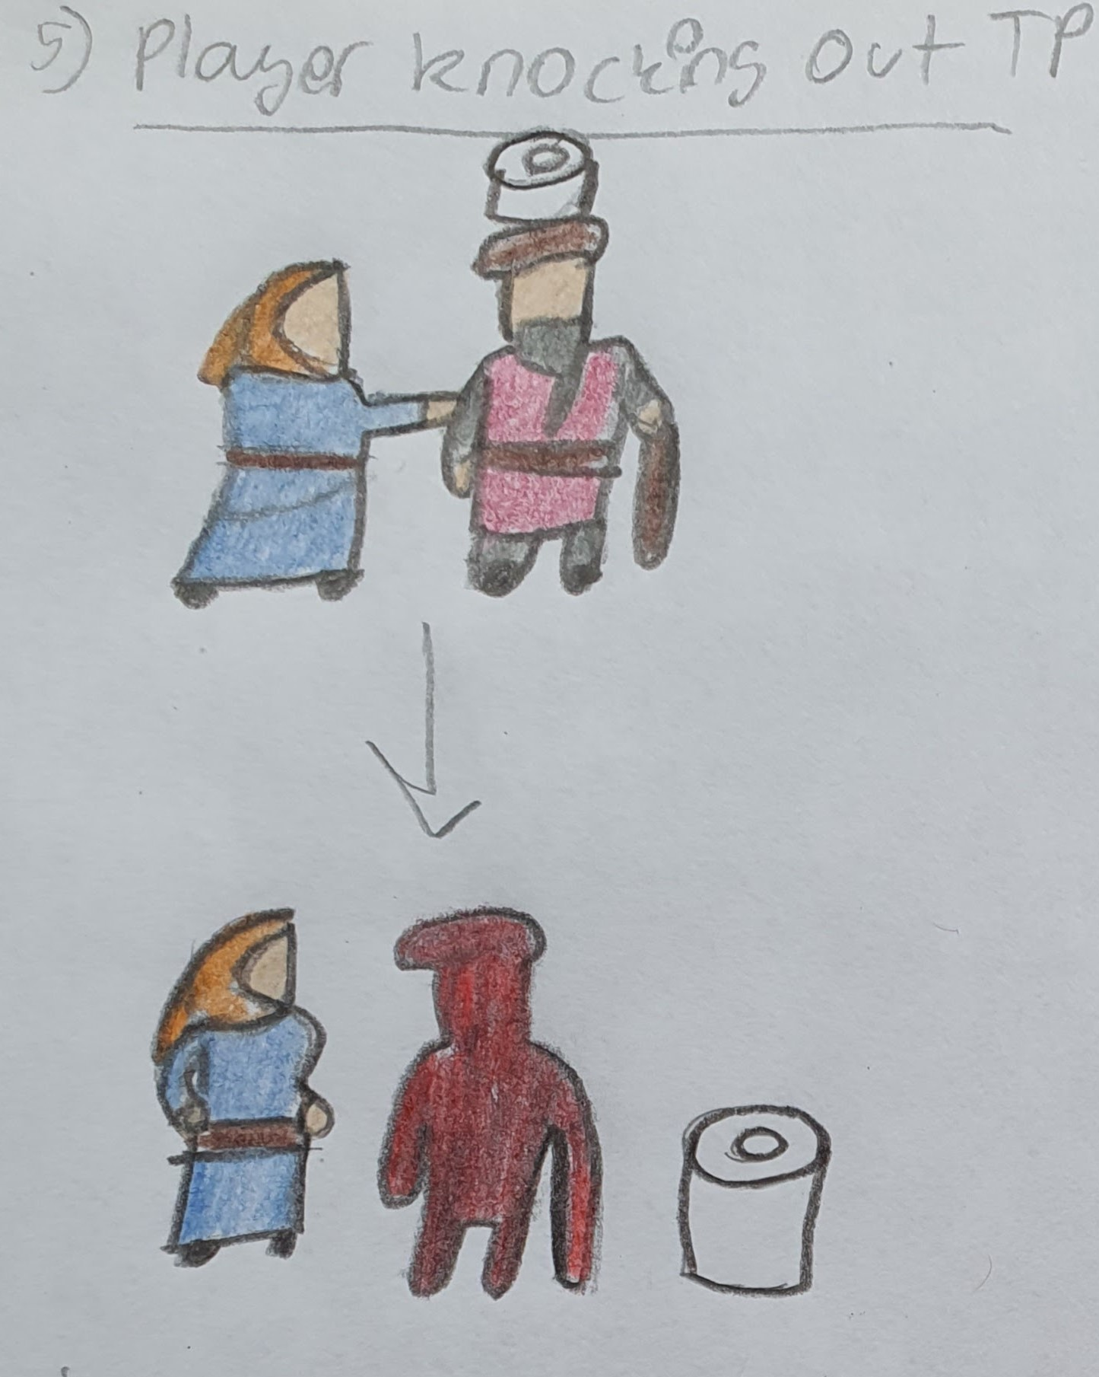
continuation

Slide 10
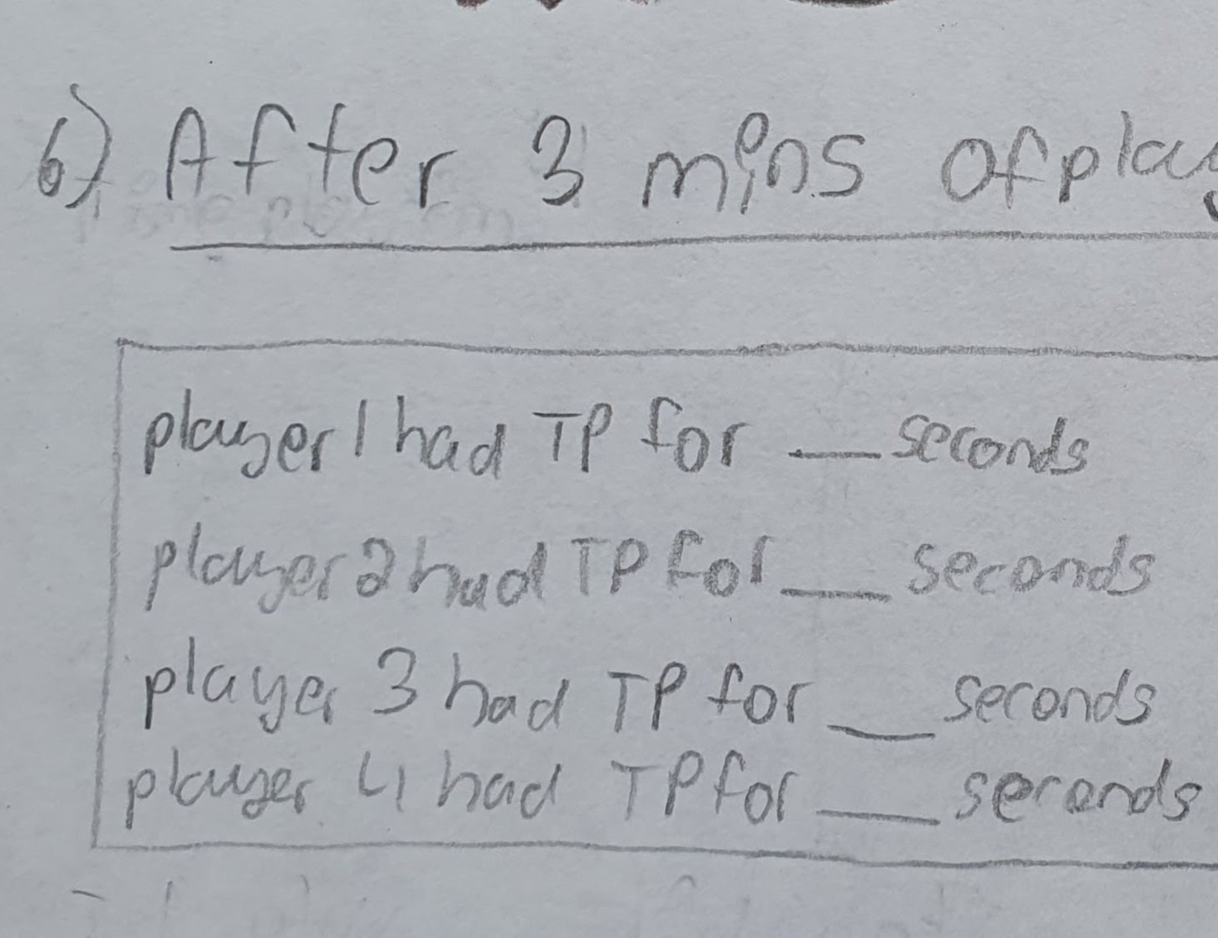
How long is game play? And what happens after?
3 Minutes !!!!

Slide 11
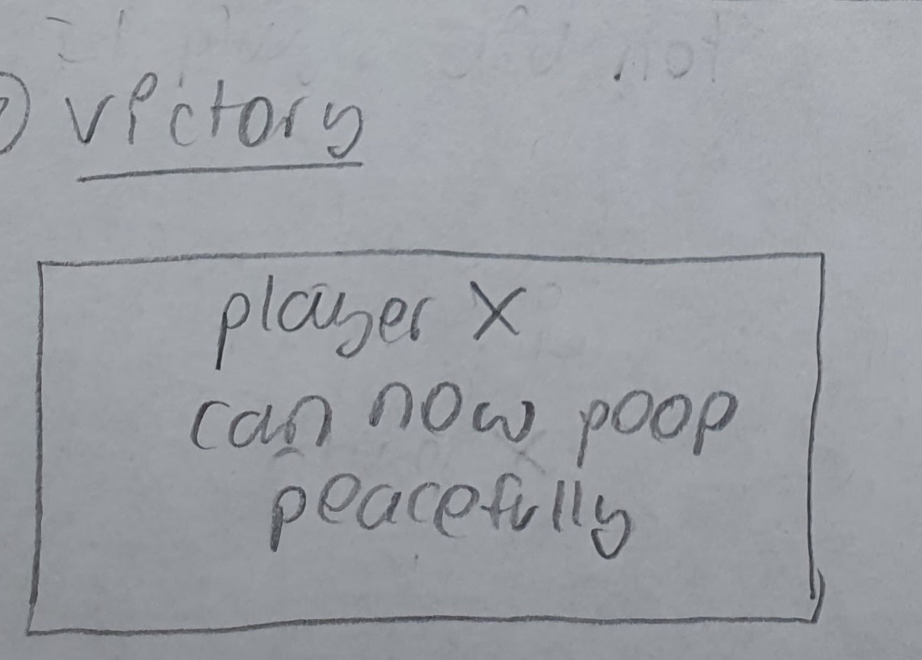
Victory Screen

